Slide 1
COMPARATIVE ANALYSIS OF PARLIAMENTARY OVERSIGHT OF INTERNAL SECURITY FORCES (ISFs) AND PRACTICES IN BELGIUM
28-29 September 2020
Workshop

Slide 2
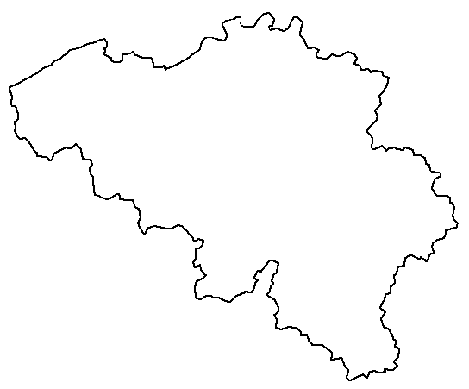
1. Introduction
Belgium
1 Country,
1 Federal Government,
1 Federal Parliament.

Slide 3
1. Introduction
Flemish region &
community
Brussels
region
Walloon region &
French community
German
community
Three Regions
Three Communities
Each has its own Parliament
Federal Parliament has oversight on police

Slide 4
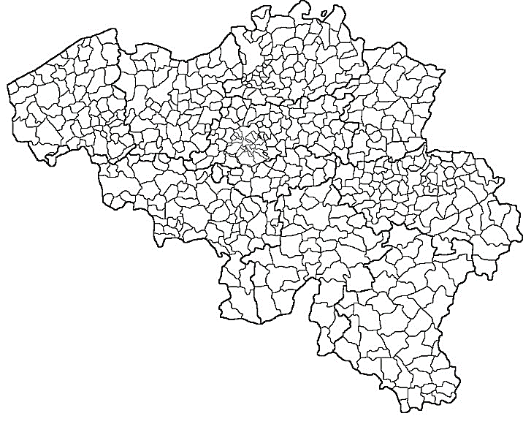
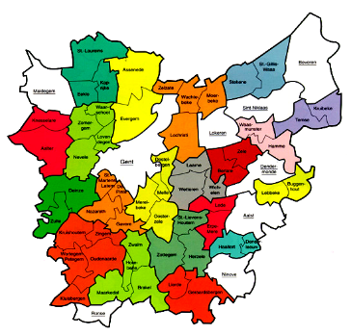
1. Introduction
581 municipalities
Each with Mayor & City Council
180 local police zones

Slide 5
1. Introduction
Legislative Power
Federal Parliament = Chamber of Representatives
Chamber has control on the government
No oversight on the judicial power
It has control on the policy of the ministers of Home Affairs & Justice
Questions and motions to the government
Preparatory work within parliamentary commissions (Home Affairs & Justice)
Parliamentary enquiry commissions (competence of investigating judge), also on criminal cases
Support services:
- Data Protection Authority (DPA)
- Court of Audit
Specific concerning police:
- Standing Police Monitoring Committee and its Investigating Service
- Supervisory Body for Police Information Management (COC)
Executive Power
Federal Government = Ministers of Home Affairs & Justice
Supervision of the ministers on police by means of their administrations
Hierarchical & disciplinary oversight
Home Affairs:
Specific concerning police:
- General Inspection of the local and federal police, complaints, assignments, discipline, … (+/- 70 members of personnel)
Internal Services for Oversight of the police, complaints etc.
Justice:
Minister of Justice : Control on the prosecution
Judges = Ruling magistrates & Investigating judges
Internal control via leading magistrates (as well for judges as members of prosecution office)
Court of Cassation
College of Courts and Tribunals (management plans)
College of Public Prosecution (management plans)
Judicial Power
Superior Council of Justice :
Independent of each power = selection and assignment of magistrates, external control via auditing, specific researches and treatment of complaints, rendering advice

Slide 6
1. Introduction
1
Gendarmerie
Nationale
(rural areas)
1998
Reform law:
“One police service, structured on two levels”
Introduction of COP
Federal Police
(supralocal, complex problems)
DECONSTRUCTION
Criminal Police
(functional specialization)
CONSTRUCTION
2
Local Police
(local, frequent problems)
3
Municipal
Police
(urban areas)

Slide 7
2. The organization
Federal Police
(Financed by
the federal state)
Local Police
(Financed by
the municipalities)
Local Police
(Financed by
the federal state)
Local Police
(Financed by
the federal state)

Slide 8
3. Parliamentary Inquiries
Installation
Treated as a Bill
Importance of public pressure
The role of the opposition
2. Competences
Competence of an investigating judge
Assistance of experts, the Standing Police Monitoring Committee
In principle public, with exceptions
Since 2014 only the Chamber can install inquiry commissions

Slide 9
3. Parliamentary Inquiries
3. Frequency
Table : Overview of parliamentary enquiry-commissions in the federal parliament dealing with police-matters (Chamber and Senate)
Enquiry-commission in the Chamber
1985: Commission on the Heizel-drama (football-disaster);
1988: Commission on the Brabant Killings I; struggle against banditry and terrorism;
1992: Commission trade in human beings; development of a structural policy;
1995: Commission on the Brabant Killings II; Changes in the functioning of police and justice ;
1996: Commission Dutroux; How the investigation was done by police and justice;
2016: Commission on terrorist assault of March 22nd; The reaction of government
Enquiry-commissions in the Senate
1980: Commission on private militia’s; Problems in maintenance of public order and private militia’s;
1996: Commission Organized Crime; Enquiry into organized crime in Belgium

Slide 10
3. Parliamentary Inquiries
4. Outcomes
4.1. Private Militia’s
Origin of its installation was the rise of extreme right militias
Eventual link between extreme right militia and the gendarmerie
“Amateurish, without significant in-depth debate”
Awareness of MP’s on police matters grew
4.2. Heyzel drama
Eurocup Liverpool-Juventus : drama
Result: Lack of collaboration between different forces
New football-law
4.3. Brabant Killings I
The three police services (gendarmerie national, municipal police and criminal police) functioned in a non coordinated way
Need to install a legal framework on the use of more intrusive methods of investigation
First time: need to reform the Police
Governmental Plan : Pentacostal Plan (Demilitarization of gendarmerie; Modernization of Municipal police; Law on the Police Function; Installation of Standing Police Monitoring Committee)

Slide 11
3. Parliamentary Inquiries
4. Outcomes
4.4. Trade of Human Beings
Public pressure: trade of women and sexual abuse
Witnesses were heard behind closed doors
The classical investigations methods were considered to be insufficient to obtain correct and complete information
Disciplinary regulation of police was deficient
Need of a deontological code for the police
Broader approach than simple criminal law
New law on Trade of Human Beings & recognition of victims
4.5. Brabant Killings II
Investigation on the investigation
Partially simultaneously with the Dutroux-Commission
Result: Prosecutor’s office had insufficient oversight and leadership on the functioning of the police
Referring explicitly to the “coming reform of the police”

Slide 12
3. Parliamentary Inquiries
4. Outcomes
4.6. Dutroux case
The case of the child abductor and murderer Marc Dutroux : a lot of public pressure
Parliament doesn’t accept any longer immobilism and resistance to change
Leaks could be observed of confidential information towards the press
Declaration of intention and proposals concerning the reform and modernization of police and justice: in favour of a qualitative and integrated police-care, structured on two levels
The Prime Minister reached a agreement on May 23th, 1998 at the occasion of a special arrangement between parties of the majority and the opposition and members of Parliament and the government. The Law of December 7th, 1998 (Reform-law) was the logic consequence of these events.
4.7. Organized Crime
Belgium doesn’t possess a clear and consistent image of criminal organisations
Important work in specific sectors, more precisely in the meat-, diamond and oil industry
Approach of organized crime may not be narrowed to a problem of penal law: a multidisciplinary approach is precondition
New law on intrusive investigating techniques
Implementation of witness protection programmes

Slide 13
3. Parliamentary Inquiries
4. Outcomes
4.8. Terrorism
Attacks on the national airport Zaventem and the metro station in Maalbeek Brussels March 22nd, 2016
Need for a more global security architecture: police and intelligence services
Inefficient efforts in terms of capacity and means; insufficient collaboration between police services; no information sharing between police units, security services, intelligence and judicial services; insufficient procedures and regulations; limited international cooperation and the complete lack of an integral security approach
Importance of prevention
Need for a more effective counter-terrorist organisation
Need of bigger police zones
Commission transformed itself in a guidance committee

Slide 14
4. Standing Police Monitoring Committee
Supervision by the federal Parliament
Standing Police Monitoring Committee
Permanent Committee,
Investigating Service,
Supporting Units;
Complaint section.
Complaints of citizens
Own initiative
Dismissal
Suit
Transfer
Demand of Parliament
Demand of competent authority
Non penal
case
Penal case
Auditing or thematic investigations, e.g. concerning stop and search techniques, confinement in police cells, interrogation methods, …
Prosecutors office
Non discipli-
nary case
Disciplinary
case
Investigating Service works under his oversight
Competent Authority

Slide 15
4. Standing Police Monitoring Committee
The Investigating Service
Investigating service researches possible penal acts, committed by members of police services
Under the supervision of the magistrate who is responsible for the investigation
All the members have the competence of an officer of judicial police
The Guidance Committee
The Standing Police Monitoring Committee is accountable to a parliamentary guidance
In 2014 a new regulation is accepted concerning the composition of the guidance committee. From now on every political fraction has at least one representative in the committee
A real monitoring of the consequences given to the recommendations formulated by both Standing Committees does not exist
Evaluation
Respondents from outside the guidance committee stress that Belgium is under severe scrutiny, compared to other European countries
Administrative sanctions are treated by the mayor (in more severe case by the minister of Home Affairs), and judicial sanctions are treated by the magistrate
Partially overlap with the functioning of the General Inspectorate; protocol between both institutions
“Frequent sanctioning is absent. Certainly at the highest level” (Chief of local police zone)

Slide 16
5. Conclusions
Belgium has with certainty the most oversight bodies on police in Europe.
The most important form of parliamentary oversight on police in Belgium is the establishment of different successive parliamentary enquiry commissions on the subject of police.
This resulted in a complete new legal framework for the police, ultimately in the reform of the police system.
Another important acquis is the fact that Parliament provided itself with a number of important oversight bodies, as the Standing Police Monitoring Committee and the Supervisory Body for Police Information Management.
These parliamentary oversight bodies provides the Parliament reports and evaluations, which permit a permanent form of oversight, like the parliamentary guidance committee on the Standing Police Monitoring Committee, which functions as a regular parliamentary commission.

Slide 17
5. Conclusions
Parliament has its own instruments for the development of a desired policy.
Moreover, the fact that a parliamentary enquiry runs simultaneously with a judicial investigation seems to be no embarrassment for success.
This form of parliamentary oversight cannot function without teamwork between Parliament and government. It is clear that the implementation of the recommendations of the parliamentary enquiry commission needs to be assumed by the government.
Oversight implies :
gathering information,
evaluation and
intervention (sanctioning).
All of the oversight bodies in Belgium, whether they belong to the legislative or executive power, perform the first two aspects mentioned. It is always to the competent administrative or judicial authorities to intervene at this level

Slide 18
5. Conclusions
As transparency is somehow missing, this is a hinderance for citizens, wondering whom to address their questions to. This fragmentation of oversight bodies results even in different databases (e.g. of complaints) of different bodies executing oversight.
Also data on the ultimate decision taken in specific cases and files is dispersed in different databases.
“What are the strengths and what are the limitations of parliamentary oversight which are critical and what should we try to measure?”
To monitor the recommendations of parliamentary enquiry commissions and their oversight bodies in terms of what has led to law making and practical implementations and (most essential) what not.
In order to increase transparency for citizens, another scoreboard would be handy. Accessible flyer mentioning the different competences of each of the oversight bodies (federal, regional and local) dealing with police complaints would be handy.

